Slide 1
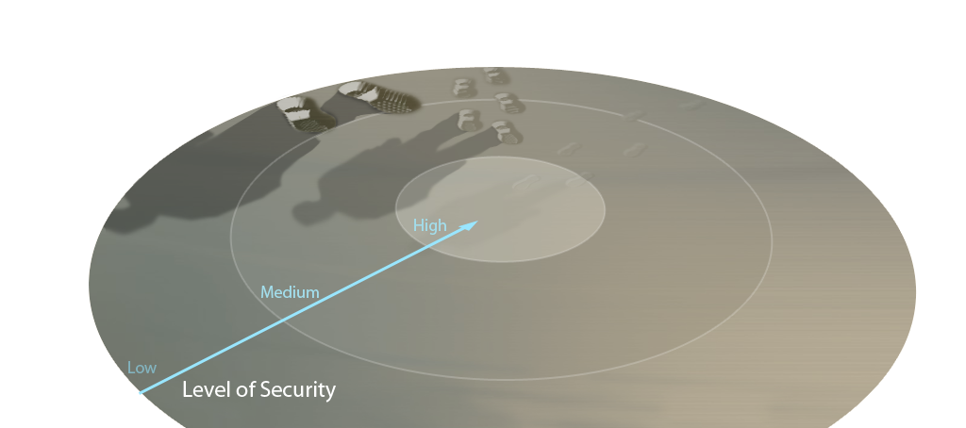
Who are the Adversaries?
Sophistication Expertise Funding Patience Target Value
Threat Level 1
Inexperienced
Limited funding
Opportunistic behavior
Target known vulnerabilities
Use viruses, worms, rudimentary trojans, bots
In it for thrills, bragging rights
Easily detected
Threat Level 2
Higher order skills
Well-financed
Target known vulnerabilities
Use viruses, worms, trojans, bots to introduce more sophisticated tools
Target and exploit valuable data
Detectable, but hard to attribute
Threat Level 3
Very sophisticated tradecraft
Foreign Intel Agencies
Very well financed
Target technology as well as info
Use wide range of tradecraft
Establish covert presence on sensitive networks
Undetectable?
Black Hat Criminal Hacker
The Careful Expert
Sophisticated and Crafted Tools
Foreign Government / Insider
Well-Managed Attack Teams
Zero-Day Vulnerabilities
Ankle Biters / Script Kiddies
The Careless Beginner
Publicly Available Tools
SECRET//NOFORN
Notes:
1

Slide 2
Top Threats to Your Organization

Slide 3
HACKTIVISTS
Although the term “hactivist” refers to cyber attacks conducted in the name of political activism, this segment of the cyber threat spectrum covers everything from individual hackers seeking thrills and bragging rights to hacker groups conducting distributed denial of service (DDoS) attacks and website defacements against government and corporate entities.

Slide 4
CRIMINAL
Organized criminal groups have easily adapted to today’s technology in exploiting the cyber arena. These groups continually attack systems for monetary gain through identify theft, online fraud, computer extortion, phishing, and spyware/malware.

Slide 5
Business Email Compromise via Social Engineering
Registars a domain close to the victim domain
@vvidgetco.com
CFO or subordinate accounts managers
@widgetco.com
Proxy Server
Spoofed e-mail from CEO to CFO requesting wire transfer
Will it be caught?

Slide 6
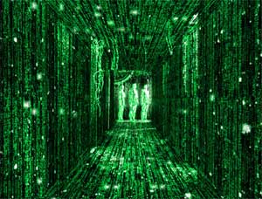
STATE ESPIONAGE
Foreign adversaries use cyber tools as part of traditional intelligence-gathering and espionage activities. These adversaries conduct computer network operations that target military and governmental organizations’ intellectual property and insider information.

Slide 7
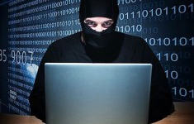
CYBERTERRORISM
Cyberterrorism is disruptive or destructive acts perpetrated against noncombatant targets at the direction, on behalf, or in support of a terrorist group or their ideology, through the use of computer network attack or exploitation. Such intrusions/attacks are intended to intimidate or coerce a government or population in furtherance of a social, political, ideological, or religious agenda by causing disruption, inducing fear, or undermining confidence.

Slide 8
STATE-SPONSORED DISRUPTIONS/WAR
Several nations are aggressively working to develop cyber warfare doctrine, programs, and capabilities. Cyber warfare enables a single entity to have a significant and serious impact by disrupting the supply, communications, and economic infrastructures that support military power – impacts that could affect the lives of citizens across the country.

Slide 9
Social Media & Your Organizations Networks
Are you proactive in messaging on social media?
How are social media accounts handled in your organization?
Business specific accounts?
Connected to organizational webpage?
Can you access personal accounts on the network?

Slide 10
Computer Incident Response
The “keys to the kingdom” is whatever data is sensitive/important to you.
Know where the keys to the kingdom are
Know the state of the keys to the kingdom (encrypted, easily accessible, unknown?)
Maintain a written CIRP with ownership, and drill the plan

