Slide 1
Cybersecurity: HELP, I’VE BEEN HACKED!
Columbia River Customs Brokers & Forwarders Association, Inc.
March 31, 2015

Slide 2
Susan Kohn Ross, Esq.
Mitchell Silberberg & Knupp LLP
11377 West Olympic Boulevard
Los Angeles, CA 90064
(310) 312-3206, Fax (310) 231-8406
skr@msk.com
www.msk.com

Slide 3
If the device can be connected to the Internet, it is susceptible to be hacked – especially with infected USB drives

Slide 4
What Is At Risk?
Everything you take for granted:
Customer and employee details,
Contracts,
Access to funds,
Telephone, email, social media and IM communication, and
All your files and records – company and personal.

Slide 5
What Is In Your System?
Valuable/Sensitive Information:
Customers’ information (contact details, payment information, pass/code words, building/security system layout, etc.).
Employee information (SSN, payroll info., etc.).
Business information (trade secrets, customer account information, etc.).
Confidentiality duty/obligation.

Slide 6
Estimated Costs
$300 billion to $1 trillion a year globally. Center for Strategic and International Studies Study by McAfee in 2014 – “In the Dark.”
In 2013, the average cost of cybercrime incurred by a benchmark U.S. organization was $11.56 million, with a range of $1.3 million to $58 million. Ponemon Institute.
Average of 122 successful attacks per week, up from 102 attacks weekly in 2012.
The average cost to resolve a hack is approximately $1 million.

Slide 7
Key Issues
PRIVACY
SECURITY
IP
PRODUCT
SAFETY
BUSINESS SECRETS
DELIVERY SERVICES
BUSINESS SECRETS
BUSINESS SECRETS
POSTAL SERVICES
OTHER

Slide 8
Hackers’ Motives
Criminal intent
Corporate espionage
State actors

Slide 9
Information: The Most Valuable Asset
Sensitive Reputational/PR concerns:
Business based on Trust → data breach may be viewed as breach of that trust and could lead to questions about competence.
Data Security = Physical Security – NO!
Digitalization of data, reliance on Internet communications and the “paperless” trend are ramping up even more than in earlier times.

Slide 10
Cybersecurity Victims
High Profile: Target, Home Depot, JP Morgan, eBay, AT&T, Michaels, Anthem, etc. However, ….
Small Businesses! Hackers are generally opportunistic, going for “low-hanging fruit.”
Source: Cybersecurity in the Golden State, California Attorney General/DOJ (Feb 2014)

Slide 11
Cyber Security Prevention
“The likelihood of a data breach is no longer a question; it is almost a certainty.”
-- Experian, 2014 Data Breach Industry Forecast
“There is probably no database that cybercriminals cannot compromise.”
-- Adm. Michael S. Rogers, Director of the National Security Agency, in light of JP Morgan security breach in October 2014

Slide 12
Is Prevention Possible?
Why so challenging?
Attackers have high incentives to intrude and little deterrence -
Cyber crime is more lucrative than illegal drugs
A network of highly organized groups, often connected with traditional crime groups
Businesses have low (immediate) incentives to invest in breach prevention
Indefinitely and exponentially evolving threats (8,000-10,000 new vulnerabilities a year; “zero”-day attacks)

Slide 13
Fire-Eye Report - 2015
“Zero-day threats are everywhere. On any given day over the last three years, cybercriminals had access to at least 85 vulnerabilities targeting widely used software from Microsoft, Apple, Oracle, and Adobe. That estimate includes only vulnerabilities that were eventually reported. The true number of zero-day vulnerabilities available to cybercriminals could be much higher.”

Slide 14
Is There Really a Problem?

Slide 15
Background
Maritime industry cybersecurity is very lax or low level.
State-of-the-art firewall and anti-virus software is ineffective in keeping out dedicated attacks.
Social engineering tactics work very well.

Slide 16
Property Security Does Not Equal Cybersecurity
When Cyberkeel asked about cybersecurity protection in the maritime industry, the answers received generally had to do with keeping intruders out. Few answered in the context of detecting intruders once in their systems.
Frequent Question - “How do we operate given the knowledge that we may at any time be compromised?”

Slide 17
Maritime Examples - Cyberkeel
2011: cyber attack on IRISL – the Iranian container carrier -
Damaged all IRISL’s data related to: rates, cargo, dates, places, parties, etc.
There was a simultaneous elimination of the company’s internal communication network.

Slide 18
Other Examples - Cyberkeel
Icefog: backdoor access to Japanese, Taiwanese and Korean companies (extract documents, gain email access, obtain passwords).
Bypass Australian customs.
Destabilization of a drilling platform.
Shut down of a drilling platform by malware infection.

Slide 19
More Examples - Cyberkeel
Complete compromise and spoofing of AIS – ship tracking system.
GPS jamming.
Manipulation of electronic data.
Remote navigation of an $80 million yacht using $3,000 worth of equipment.

Slide 20
And even more examples
Stealing money through man-in-the-middle attacks.
Smuggling drugs and deleting containers from a terminal’s computer system.
Zombie Zero: Using barcode scanners to gain entry to financial systems – TrapX – manipulated the data.

Slide 21
Cyberkeel Findings
Cyberkeel evaluated the top 50 container carriers’ websites
37 appear completely open to simple attacks towards back-end systems.
6 allow harvesting of usernames.

Slide 22
More Findings - Cyberkeel
8 carriers, controlling 38% of global trade, allow “password” as a password to access sensitive eCommerce applications.
2 carriers allow “x” as a password.
Spoof domains are in place for 10 of the top 20 carriers.

Slide 23
Senate Armed Services Committee Report -
“Inquiry into Cyber Intrusions Affecting U.S. Transportation Command Contractors.”
Report period - June 2012 to March 2013.
Declassified and released September 17, 2014.

Slide 24
Senate Report - More
Most contractors are civilian airlines (some 30 or so which make about 90% of the passenger moves for Defense and have more than 1/3 of the bulk cargo capacity) and vessel operators (which in 2012 moved about 95% of Defense’s dry cargo).

Slide 25
Successful Intrusions
Into the controlling computer of a vessel at sea, separately into that of an airplane and also into a logistics providers system!
Obtained emails, documents, flight details, credentials and personal identification numbers, user accounts, passwords (some for encrypted emails) and source codes.

Slide 26
What Happened?
Hackers were Chinese - so national security and espionage involved.
Phishing email used – an email masquerading as coming from a trustworthy entity.

Slide 27
Relevant Standards
Federal – no statute, but the NIST standards; federal prosecutors use other statutes to gain convictions, e.g. mail fraud, wire fraud, conspiracy, etc.
States – 45+ have adopted related privacy and notice laws – and each is different.
Does your industry have a cyber standard?

Slide 28
Framework For Action
C-Suite Attention
Pre-Breach Actions
Post-Breach Remedies

Slide 29
C-Suite Attention
Cybersecurity is no longer “just” for the IT Director.
Headaches from BYO devices.
Cost – benefit balancing.
Leadership should be paying attention to and managing IT system risks.

Slide 30
Pre-Breach Issues/Measures
Regulatory Framework/Standards.
Vulnerability Assessments/IT Protections.
Training and SOPs (frequent training, regular SOP reviews and updates, backup and testing, strong passwords, physical access controls, limits on the use of USB drives).
Emergency Preparedness Plan to include outside supporting experts, including counsel, technology and insurance.

Slide 31
Post-Breach Crisis Management
Secure Your System
Contact Counsel, Insurer, PR Team, and possibly Law Enforcement
Comply with Data Breach Notification Laws
Implement Your Preparedness Plan

Slide 32
Post-Breach Issues
Preserve evidence/do not turn off computer.
Confirm what data you have and what is on or off-site in the hands of third parties, including employees and vendors.
Complete a forensics investigation to determine the nature and severity of the incident.
Implement emergency preparedness/business continuity plan - who says what to whom, when and how?
PR: Tell the truth without creating judicial admissions; maintain control over the information and your credibility.
Bring in an expert to interact with the government and the media (Counsel, PR and IT).
Reevaluate/reassess your emergency response plan and insurance coverage.

Slide 33
National Institute of Standards and Technology

Slide 34
NIST Special Publication 800-122
Personally identifiable information or PII is "any information about an individual maintained by an agency, including (1) any information that can be used to distinguish or trace an individual‘s identity, such as name, social security number, date and place of birth, mother‘s maiden name, or biometric records; and (2) any other information that is linked or linkable to an individual, such as medical, educational, financial, and employment information."

Slide 35
NIST - More
By way of example, a user's IP address as used in a communication exchange is classed as PII regardless of whether it may or may not on its own be able to uniquely identify a person.

Slide 36
Commercial Definition – PII
Individual’s name – along with one of the following -
Social Security No.
Driver’s License No. or
Financial account number in combination with any security code, access code, or password.

Slide 37
NIST – PII Defined
Name, such as full name, maiden name, mother‘s maiden name, or alias.
Personal identification number, such as social security number (SSN), passport number, driver‘s license number, taxpayer identification number, or financial account or credit card number.

Slide 38
NIST – PII
Address information, such as street address or email address
Personal characteristics, including photographic image (especially of face or other identifying characteristic), fingerprints, handwriting, or other biometric data (e.g., retina scan, voice signature, facial geometry).

Slide 39
NIST - PII
Information about an individual that is linked or linkable to one of the above (e.g., date of birth, place of birth, race, religion, weight, activities, geographical indicators, employment information, medical information, education information, financial information).
Partial List – what leads to identifying the specific individual?

Slide 40
Federal Standard

Slide 41
Background
Improving Critical Infrastructure Cybersecurity – EO 13636 – February 2013
Cybersecurity Framework – NIST Standards – February 2014
Promoting Private Sector Cybersecurity Information Sharing – EO 13691 – February 2015

Slide 42
NIST Standards Elements
Identify
Protect
Detect
Respond
Recover

Slide 43
Framework Standards
Provide a unified process by which to evaluate your cybersecurity program:
1) Describe your current cybersecurity posture;
2) Describe your target state for cybersecurity;
3) Assess progress toward your target state;

Slide 44
Framework Standards
4) Identify and prioritize opportunities for improvement within the context of a continuous and repeatable process; and
5) Communicate among internal and external stakeholders about cybersecurity risk.

Slide 45
Framework Core
The Core covers five concurrent and continuous functions — Identify, Protect, Detect, Respond, Recover — designed to provide a 100 foot view of the lifecycle of an organization’s management of cybersecurity risk.

Slide 46
Framework Core
For each of these lifecycle functions, the Core then identifies underlying key categories, and subcategories, and matches them with exemplar references, such as existing standards, guidelines, and practices.

Slide 47
Framework Implementation Tiers
Provide a numerical representation of how advanced an organization’s risk mitigation procedures are, given the threat environment, legal and regulatory requirements, business/mission objectives, and organizational constraints. The Tiers range from Partial (Tier 1) to Adaptive (Tier 4).
“Progression to higher Tiers is encouraged when such a change would reduce cybersecurity risk and be cost effective.”

Slide 48
Framework Profile – Results
A Profile enables the organization to establish a road map for reducing cybersecurity risk in a manner aligned with organizational and sector goals, considers legal and regulatory requirements and industry best practices, and reflects appropriate risk-management priorities.

Slide 49
Framework Profile - Results
Armed with the results or ranking, the Framework allows the organization to evaluate risk vulnerabilities and create a prioritized action plan to address those gaps.
The question for all companies then becomes how best to adapt to these new recommendations and do so in a cost-effective and meaningful manner.

Slide 50
NIST Standards Elements
Identify
Protect
Detect
Respond
Recover

Slide 51
Facebook Threat Exchange
Facebook, Printerest, Tubmlr, Twitter, Yahoo, Dropbox and Bit.ly.
The stated goal is to locate malware, the source domains and the IP addresses which are involved as well as the nature of the malware itself.
https://threatexchange.fb.com/.

Slide 52
Executive Order - EO 13691
“Strongly” encourages the development and formation of Information Sharing and Analysis Organizations (ISAOs)
National Cybersecurity and Communications Integration Center is to engage in “continuous, collaborative and inclusive coordination with ISAOs on the sharing of information related to cybersecurity risks and incidents”.

Slide 53
ISAOs
ISAOs are to develop voluntary standards for “robust” information sharing regarding risks and incidents, including automated information sharing mechanisms
Standards for members to include
Contract language
Business processes
Operating procedures
Technical means
Privacy protections
Be consistent with voluntary international standards

Slide 54
Legal Fallout From An Intrusion
Federal and state investigations.
Internal investigatory costs.
Legal, forensic specialist, firings, terminations, process changes, system expenses (hard and soft), reputation and so on.
Shareholder derivative actions.
Class action lawsuits.

Slide 55
Supply Chain Security
C-TPAT – AEO.
Mutual recognition – Canada, EU, Japan, Jordan, Korea, New Zealand and Taiwan.
Human trafficking.
Lost or damaged cargo.

Slide 56
Internal Investigation – Initial Questions
1) Are there government agencies to which we are obliged to give notice about what happened? If so, is there a specific time frame under which we must act?
2) What do we tell our customers and clients, and when?
3) What do we tell our staff, and when?
4) Who on our staff was involved and what punishment is merited? Is our only choice to fire the people involved?

Slide 57
Investigation – Initial Questions
5) When do we tell our Board? Shareholders? Should we report what happened to law enforcement? If so, to what agency and when?
6) If a vendor was involved, must we change vendors? If so, how quickly? Can we afford to cut off that vendor?

Slide 58
Investigation – Best Practices
Call your outside lawyer, then jump right in.
Preserve all available evidence as soon as possible and before meeting with witnesses.
Chase down all reasonable leads, regardless of where they might take you, ask the tough questions, and be flexible.

Slide 59
Vet Your Business Partners
Do they have the equipment, facilities and staff to work with your company and provide quantity and timeliness?
Do they comply with local labor and social laws?
Do they fully understand any special or regulatory requirements?
Are they willing to promptly inform you when changes are made?

Slide 60
More Factors
What about other changes that effect compliance?
Do you regularly check their cyber and other security measures?
Have you tested if they interface with you in a secure manner?
Regularly document your efforts and keep those records.

Slide 61
State Requirements Clearly
Use your purchase order to clearly state your expectations.
Include penalties for non-compliance with your requirements.
Use whatever commercial leverage you have to insure compliance.

Slide 62
Periodic Verification
Periodically verify the information being given you by your business partners.
Do not simply collect documents – assign someone to verify information and do so regularly and in a timely manner.

Slide 63
Cybersecurity Insurance
Cyber Security Insurance -
Insurer’s panel of vendors, such as legal counsel, PR and forensics or breach response providers.
Insurer’s standards include employee training-
General awareness (phishing, suspicious emails, attachments, downloads, password/login credentials protection, physical security); and
Specific training related to the type of tasks, data and software handled.

Slide 64
Insider Threat
Secret Service Study of Insiders Attacks -
81% planned their actions in advance,
81% were motivated by financial gain,
23% acted out of revenge,
33% were identified as difficult, and
17% were disgruntled.

Slide 65
Prevention re Insider Threat
Vetting employees and contractors with access
Robust SOPs reviewed and signed by employees
Regular and on-going training

Slide 66
What Needs To Be Done?
Increased awareness re the real threat picture.
Develop plans and counter-measures.
Improved training and awareness –
C-level plus all staff and vendors.

Slide 67
Categories of Laws At Issue
Privacy laws and policies (including your website).
Recording statutes.
Telemarketing and telephone sales.
CAN-SPAM Act of 2003 (unsolicited emails).
Fair Credit Reporting Act (FCRA).

Slide 68
Your Contracts
Customer Agreement:
Privacy provisions
Limitation of liability
Specific risks re data breach
Disclosures/disclaimers regarding data risks
Minimize sensitive data retained
Consent to recording
Electronic Contracts/Signature

Slide 69
More Thoughts
Should there be industrywide cybersecurity standards?
Given the current anti-trust and other limitations, should a trusted environment be created in which companies may share cyber attack information?

Slide 70
Final Thought!
Should C-TPAT/AEO be expanded to include cybersecurity?
No – but what else is there?

Slide 71
Deals are no longer just about quality, cost and delivery date

Slide 72
It Really Is All About Due Diligence

Slide 73
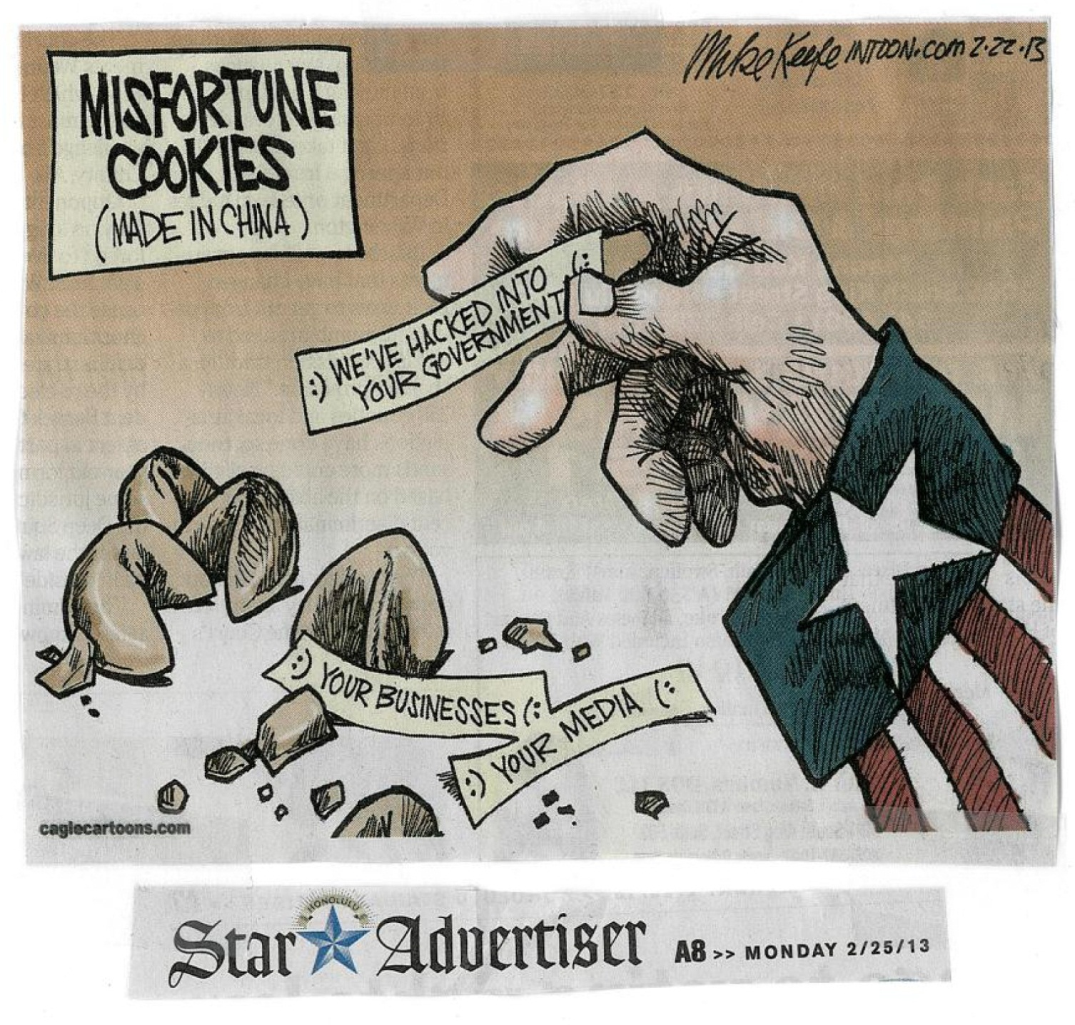

Slide 74
MITCHELL SILBERBERG & KNUPP LLP
Website: www.msk.com
Washington, D.C.
New York, NY
Los Angeles, CA
Office: 310-312-3206 Fax: 310-231-8406

