Slide 1
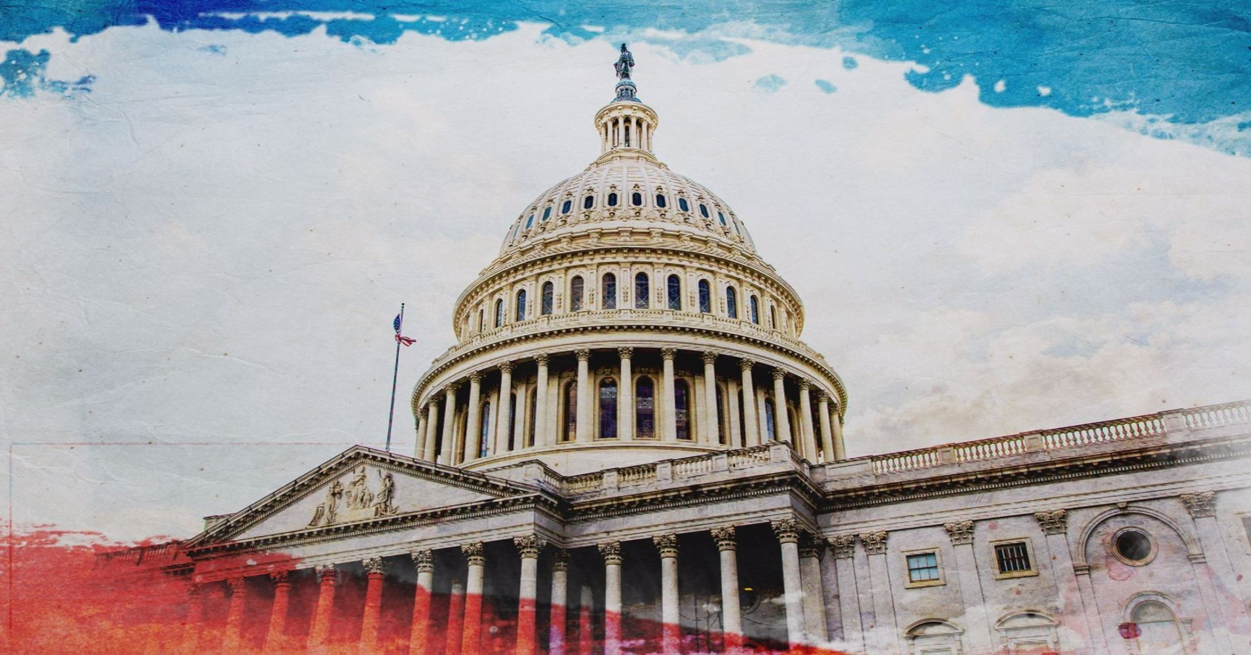
Mission To DC - 2019
TRADE REMEDY ACTIONS – Section 232 and 301
USMCA vs NAFTA vs Withdrawal
LOW VALUE SHIPMENTS – “86” Entries
NEW 5106 REQUIREMENTS
FMC – Best Practices to Negotiate Demurrage
2 Bonus Slides

Slide 2
Trade Remedies
Section 232 – Tariffs on imported steel and aluminum.
Encouraged to lift these tariffs and resist imposing tariffs on auto imports.
Section 301 – China tariffs
We agree that China is a bad actor and that the U.S. cannot let the Chinese off the hook in regards to IP violations and theft of U.S. Technology.
Keeping tariffs in place indefinitely is not the answer.
Legislation to Support:
S.287(Portman –OH)/H.R.940(Gallagher-WI)
Would allow Congress to pass a resolution of disapproval to block presidential trade actions.
Import Tax Relief Act: (H.R.1452 and S.577)
Would require USTR to establish an exclusion process for the List 3 tariffs (or any future list).

Slide 3
USMCA vs NAFTA vs Withdrawal
North American Free Trade Agreement (NAFTA)
Implemented January 1, 1994
Designed to continue indefinitely (no expiration date)
Labor provisions included but without real enforcement teeth
All parties agree that NAFTA needed to be updated
United States – Mexico – Canada Agreement (USMCA)
NAFTA renegotiated into new Free Trade Agreement
US / CA/ MX signed agreement on November 30, 2018
US Congress must ratify
Effective date most likely early 2020; reviewed every six years and could expire in 2036, or be extended to 2052

Slide 4
USMCA Congressional Concerns
Labor: stronger labor provisions and enforcement procedures not currently included in Mexico law; without change in their law, labor provisions remain unenforceable
Biologics: allows 10 year patent protection on drugs before generics can be offered; longer period that currently in force in CA (8 years) and MX (5 years); 12 year protection in US that Democrats were hoping to negotiate to a lower term
232 duties on steel / aluminum remain in place (non-starter for many in Congress)

Slide 5
USMCA Major Changes
Market access for dairy products into Canada
Implemented January 1, 1994
Automobiles Rule of Origin
Must contain 75% US / CA/ MX content
Starting in 2020, 30 percent of vehicle production must be done by
workers earning an average production wage of at least $16 per hour
(3x average pay of Mexican autoworker)
Intellectual Property Rules Stiffened
Law enforcement officials can stop suspected counterfeit or pirated goods
in any of the three countries

Slide 6
ACE Entry Type 86 (Section 321 De Minimis)
For imports valued at $800 or less, entered duty free with no formal customs entry process required.
Section 321 entries are currently a manual process by CBP.
Entry Type 86 will allow Customs Brokers to file Section 321 entries electronically via ACE.
Entry Type 86 is designed to file a section 321 entry and provide the required PGA data set, while still enjoying the duty-free provisions of a Section 321 entry.
The pilot program is to begin August 2019 and will be open to all filers from the opening date.

Slide 7
New Customs Form 5106
New 5106 form deployed March 16, 2019
The only new required data elements on the revised form are:
Email address for the IOR; and
Type of address(es).
The new optional data elements on the revised form are:
Estimated entries per year;
How the IOR will be used (Importer, Consignee, etc.);
Trusted Trader program codes;
Fax number;
Website;
Business Description;
North American Industry Classification System (NAICS) code;
Dun & Bradstreet Number (D-U-N-S);
Filer Code;
Year established; o Related business entities Employer Identification Numbers (EINs);
Banking information;
Certificate or articles of incorporation information; and
Information for up to four beneficial owners and/or company officers.

Slide 8
New Customs Form 5106
Why the new 5106? Mandated under TFTEA – Trade Facilitation and Trade Enforcement Act of 2016 as the Importer of Record Program. Goals are to:
Establish criteria to ensure sufficient information is collected to allow U.S. Customs and Border Protection to verify the existence of the importer requesting the importer of record number
Establish criteria to ensure sufficient information is collected to all U.S. Customs and Border Protection to identify linkages or other affiliations between importers that are requesting or have been assigned importer of record numbers; and
Establish criteria to ensure sufficient information is collected to allow U.S. Customs and Border Protection to identify changes in address and corporate structure of importers
Foundation of other TFTEA requirements such as TFTEA 115 and 116 – the Importer Risk Assessment Program and Validating Importers

Slide 9
New Customs Form 5106
Trade Concerns:
Validating addresses – USPS instructions and city validations
Wiping out previously saved information
Freezing or locking down 5106 data
Bond queries
Intersection with CBP voiding importer of record numbers

Slide 10
FMC – Best Practices to Negotiate Demurrage
Fact-Finding Mission 28 - Commissioner Rebecca Dye
Why is there demurrage?
Good Intentions
Incentives
Purpose of the Charge
The FMC is not open to discussing demurrage involving U.S. Customs
Best Practices – via OCEMA -Ocean Carrier Equipment Management Association (same association involved in VGM-verified gross mass)
Each Carrier to post on its own website
Website should include
Who to call or contact
Phone number and/or email
Process to go through in disputing demurrage fees

Slide 11
Advanced Manifest to lead to Post-Departure Filing
COAC has a new Working Group - Export Modernization WG
Focus on Policies and Procedures for advance manifest for all modes of transportation
Air
Ocean
Truck
Rail
Once Advanced Manifest Data is received, then the Post-departure can be revitalized (been on hiatus since October of 2002)
Will require Customs changing some regulations
Will take some regulatory changes by Census, too

Slide 12
Self-Propelled Vehicles
Some pilots are testing these concepts now in the ports of Houston & Atlanta
Once AES is submitted with the VIN number, the process will start and the ACE Portal will dictate what will be required to fulfill the requirements
Similar to DIS – you will be able to submit documents such as a title, bill of sale, etc.
Between the AES transmission advising the next step and what to submit, it is expected to make the process uniform for all ports of exit.
No unique forms for each port
No unique document requests

Slide 13
Questions?
Thank you,
All of us
(Ali Halseth, Judy Haggin, Chuck Willis, Laura Flor, and Brenda Barnes)

