Slide 1
Are you Prepared for
Presentation for the Columbia River Customs Brokers and Forwarders Association
Presented by:
Terry Cummings, Vice President
Roanoke Trade November 19, 2014

Slide 2
In this Presentation…
What is eBond
Where is CBP with eBond development?
How will it work?
Benefits of eBond
Important Dates to remember

Slide 3
Poll!
Are you currently using ACE Cargo Release to file entries?
A – Yes, for most entries
B – Yes, for some entries
C – No, not yet

Slide 4
Poll!
Of the entries you file in ACE Cargo Release, how many are secured by an STB?
A – Yes, for most entries
B – Yes, for some entries
C – None

Slide 5
What is eBond?
Electronic system for submitting customs bonds
Surety submits to ACE via EDI
Allows for STBs and Continuous Bonds to be accepted electronically
Provides a single, centralized data warehouse for all customs bonds
Notes:
Colleen

Slide 6
eBond Development Status
CBP initiated visits to ports in 2013
eBond Working Group Members (Trade & CBP)
TSN eBond & Surety Subcommittees, other interested parties
Development completed in November 2014
Deployment in January 2015
Notes:
Colleen

Slide 7
eBond Functionality (January 2015)
ACE STBs
For ACE cargo release entry only
Continuous Bonds, Riders
Bond Status Messages to Surety/SNP (Broker)
Bond User interface for CBP users
Bond validations for ACE Cargo Release & ACE Entry Summary
Notes:
Colleen

Slide 8
eSTB Process
How will it work?

Slide 9
How will it work?
Single Transaction Bonds (STBs) – EDI Transmission
Surety Bond Issuing System
Requires keying data from entry information
ABI software
Direct communication from broker’s ABI to surety/surety agent system
Implementation Guide available

Slide 10
The Approval Process

Slide 11
eSTB Issuing Authority - Brokers
Process Change
Surety/surety agent must file bond data
Customs Brokers
Issuing authority
Over 95% of all STBs within issuing authority
Average STB amount is $25,000

Slide 12
CBP’s eSTB Data Flow Concept

Slide 13
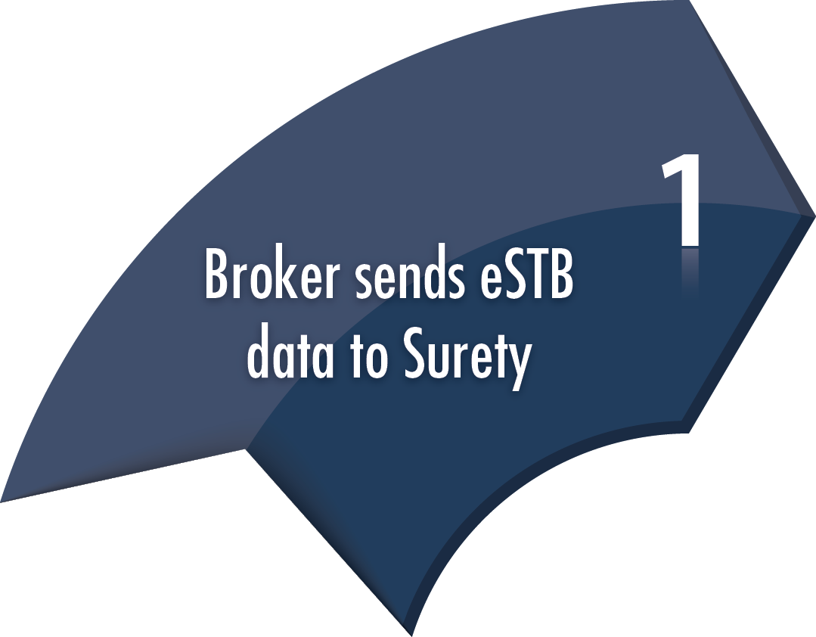
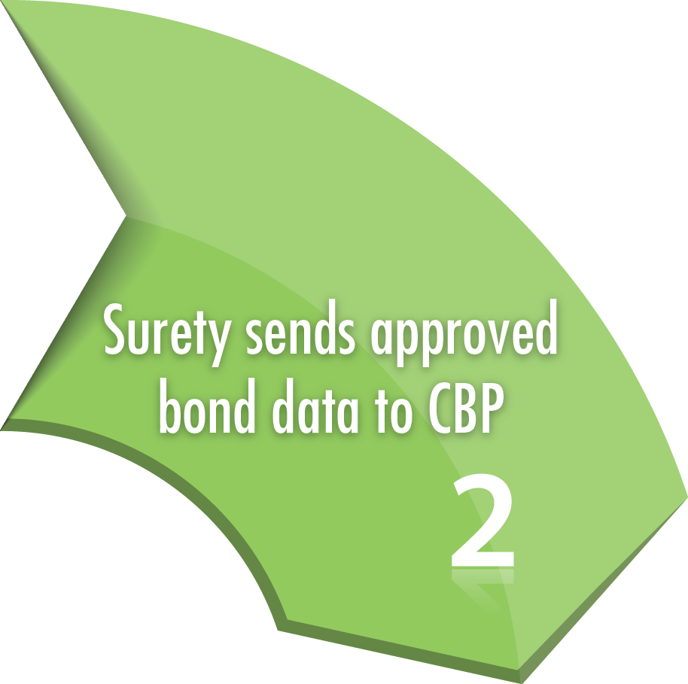
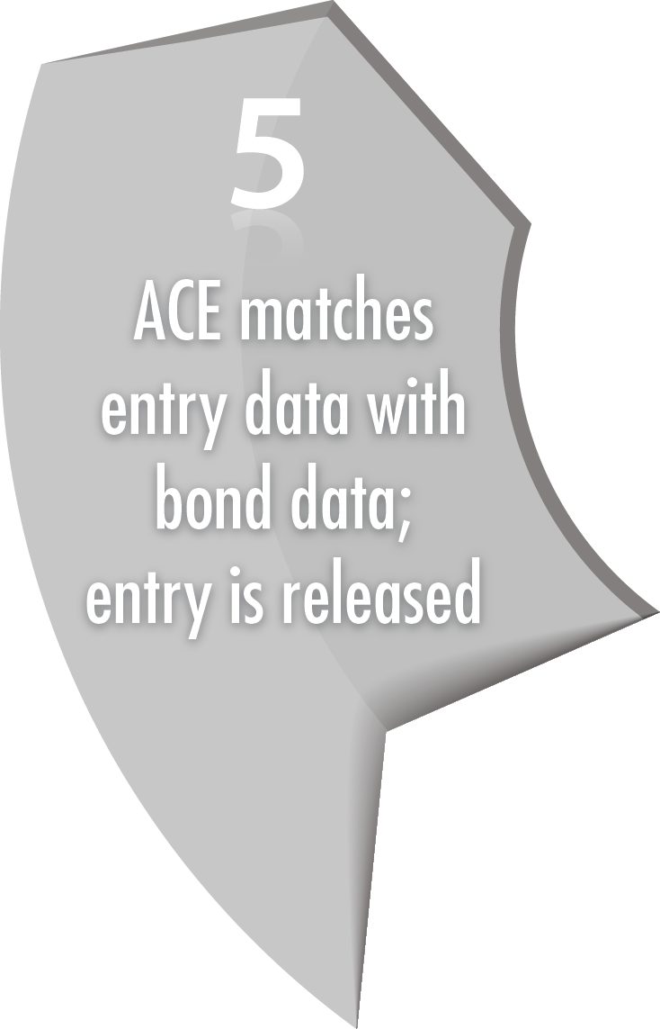
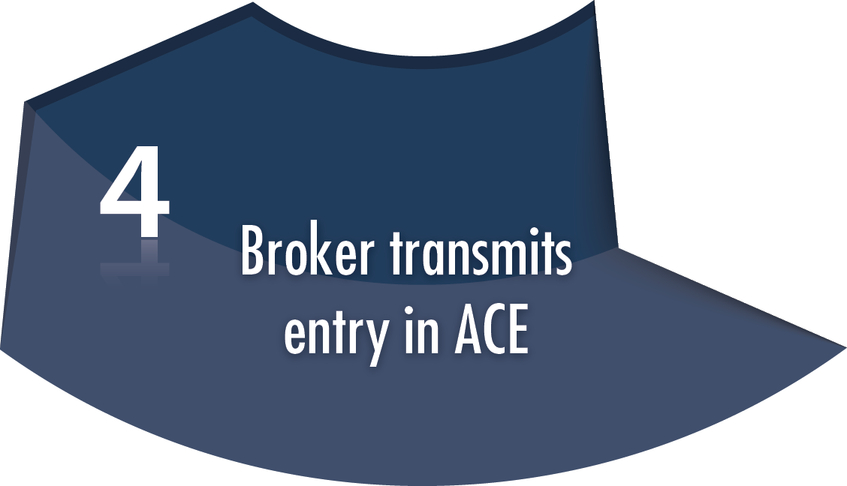
The eSTB
Process
5 Steps
Use your surety bond issuing system or talk to your ABI software vendor about automation options!

Slide 14
Broker/Filer
eBond Process Automatic Approval
Request an STB for entry
Notified of eSTB transmission
Surety/Surety’s Agent
Uses data to determine if to accept liability for entry
Accept
Submits eSTB (CBP301) to ACE
What data will we check?
CBP/ACE
Validates eSTB

Slide 15
Broker/Filer
eBond Process Automatic Approval
Notified of eSTB in ACE (SNP)
Submit Entry/Entry Summary to ACE
First time in eSTB process where Broker/Filer sends anything to CBP
Surety/Surety’s Agent
Notified eSTB on file in ACE
CBP/ACE
Accept
eSTB stored in ACE
Validate E/ES (eSTB data included)

Slide 16
Broker/Filer
eBond Process Automatic Approval
Broker/Filer Receives Acceptance
Surety/Surety’s Agent
Notice of Entry-Bond Match
CBP/ACE
Entry process eligible

Slide 17
How will it work for ISF STBs?
CBP requires ISF Transaction number in the bond transaction
Process for obtaining bond remains the same
Once ISF STB is executed, the bond data will be sent, via EDI, from surety system to CBP

Slide 18
eContinuous Bond Process
How will it work?

Slide 19
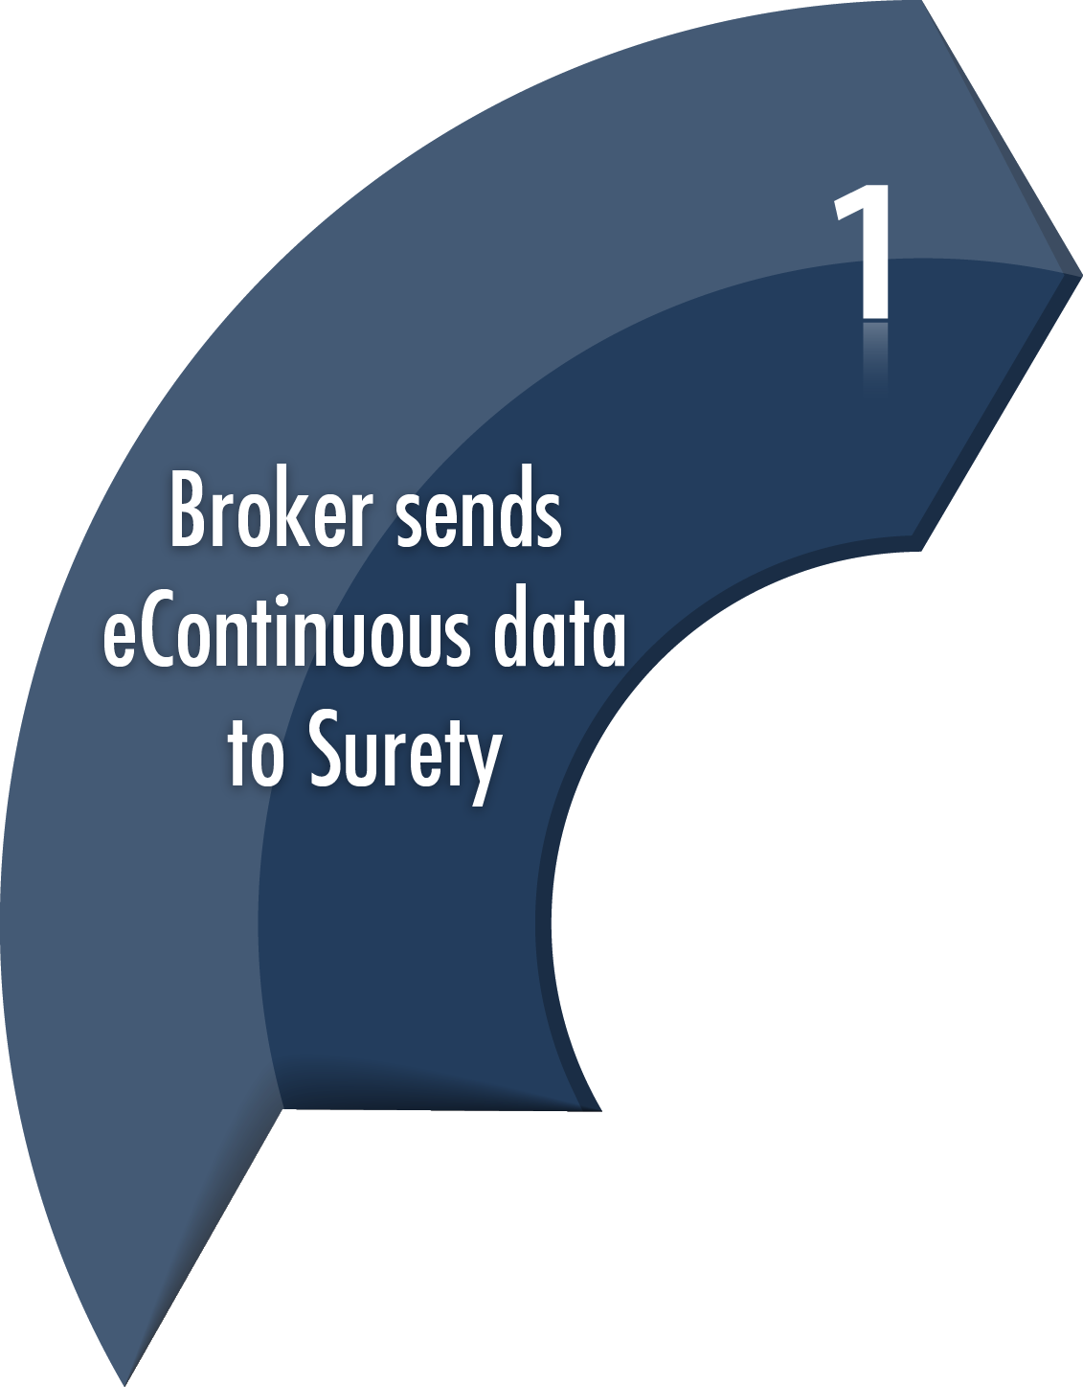
The eContinuous Bond Process
3 Steps
Use surety bond issuing system to issue continuous bonds as you do today!

Slide 20
eContinuous Bonds
Terminations
Electronic vs Paper
Riders
Add/Delete User
VI, Reconciliation
Legacy (existing) Bonds
1/3/15: Continuous Bonds filed electronically

Slide 21
Transition to eSTB

Slide 22
Six Scenarios – eSTB vs Paper STB
eSTB
ACE Cargo Release followed by ACE Entry Summary (2 step process)
ACE Entry Summary Certified for ACE Cargo Release
Paper STB
ACS Entry followed by ACE Entry Summary (2 step process)
ACE Entry Summary Certified for ACS Cargo Release
ACS Entry followed by ACS Entry Summary (2 step process)
ACS Entry Summary Certified for Cargo Release

Slide 23
eBond Testing

Slide 24
Certification Environment
CB/CX Messages (eBond CATAIR)
1st Test Deployment began for sureties 9/3/14
Initial testing response 50 seconds
2nd Test Deployment 10/10/14
Response now 4 seconds

Slide 25
How does eBond Benefit the Broker?
Expedites bond issuance process – all electronic
No more bond forms
Potential for 24/7/365 bond issuance
eSTB use for RLF
Quicker acceptance of Continuous Bonds
Surety reports

Slide 26
What are the challenges?
Few brokers use ACE
ACE will be the system of record for all cargo release in November 2015
eBond Deployment in January 2015 for ACE entries
Two processes for a time

Slide 27
How to prepare for eBond ?
Know your software provider automation process
Understand your surety bond provider process
ABI Software vs Surety Bond Issuing System
Which will you use?
Know your bond issuing authority
Broker Staff Training

Slide 28
Poll!
Do you think CBP will meet the January 3, 2015 deadline for eBond?
A – Yes!
B – No - I’ll believe it when I see it.

Slide 29
Important Dates to Remember
January 3, 2015: eSTB required for all ACE entries and eContinuous bonds
November 1, 2015: Mandatory use of ACE for cargo release & entry summary
October 1, 2016: Mandated use of ACE for all remaining portions of CBP cargo processing

Slide 30
References
Join our mailing list
Check out our website’s Emerging Matters blog section on eBond
NCBFAA.gov posted CSEC FAQ and Implementation Guide

Slide 31
It’s time to Embrace ACE

Slide 32
The result-driven surety provider for eBond
1-800-ROANOKE
www.roanoketrade.com infospot@roanokegroup.com
#RoanokeTrade | @RoanokeTrade

